Slide 1
Architecture of Enterprise Applications 20 Data Lake
Haopeng Chen
REliable, INtelligent and Scalable Systems Group (REINS)
Shanghai Jiao Tong University
Shanghai, China
http://reins.se.sjtu.edu.cn/~chenhp
e-mail: chen-hp@sjtu.edu.cn

Slide 2
Contents and Objectives
Contents
Data Lake
Objectives
能够了解主流云原生数据库的基本概念和特点，理解数据湖的特征的技术难点

Slide 3
What is Data Lake？
A data lake is a system or repository of data stored in its natural/raw format, usually object blobs or files.
A data lake is usually a single store of data including raw copies of source system data, sensor data, social data etc., and transformed data used for tasks such as reporting, visualization, advanced analytics and machine learning.
A data lake can include structured data from relational databases (rows and columns), semi-structured data (CSV, logs, XML, JSON), unstructured data (emails, documents, PDFs) and binary data (images, audio, video).
A data lake can be established "on premises" (within an organization's data centers) or "in the cloud" (using cloud services from vendors such as Amazon, Microsoft, Oracle Cloud, or Google).

Slide 4
What is Delta Lake?
A data lake is a centralized repository designed to store, process, and secure large amounts of structured, semistructured, and unstructured data.
It can store data in its native format and process any variety of it, ignoring size limits.
A data lake provides a scalable and secure platform that allows enterprises to:
ingest any data from any system at any speed—even if the data comes from on-premises, cloud, or edge-computing systems;
store any type or volume of data in full fidelity;
process data in real time or batch mode;
and analyze data using SQL, Python, R, or any other language, third-party data, or analytics application.

Slide 5
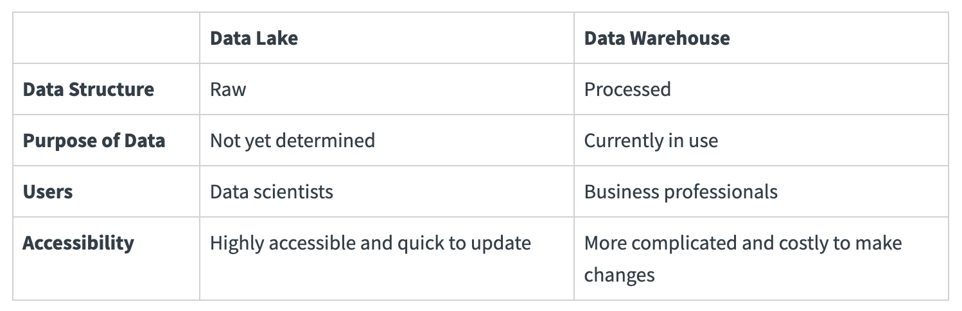
Data lake vs data warehouse
Four key differences between a data lake and a data warehouse

Slide 6
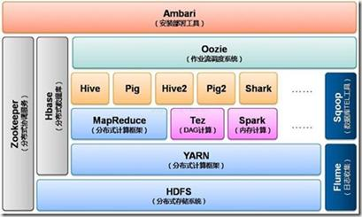
Data Lake – 演化历程
以HDFS为核心存储，以MapReduce为基本计算模型

Slide 7
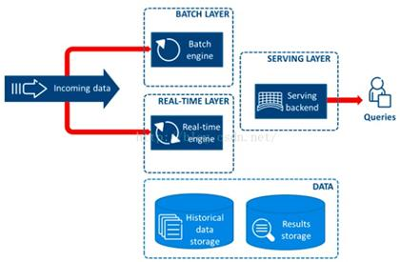
Data Lake – 演化历程
HDFS批处理无法满足实时性要求高的场景，因此产生了lambda架构“流批一体”

Slide 8
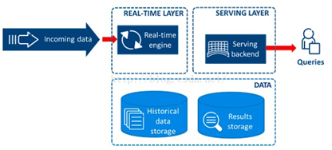
Data Lake – 演化历程
加大流计算的并发性与“时间窗口”，统一流/批处理

Slide 9
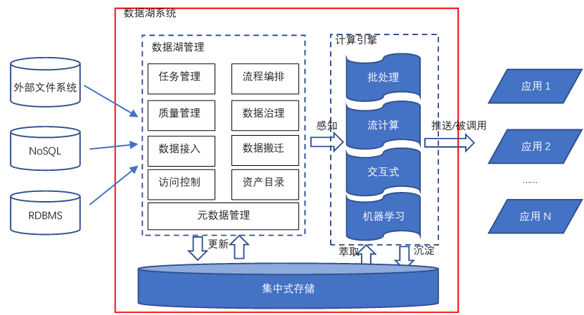
数据湖架构

Slide 10
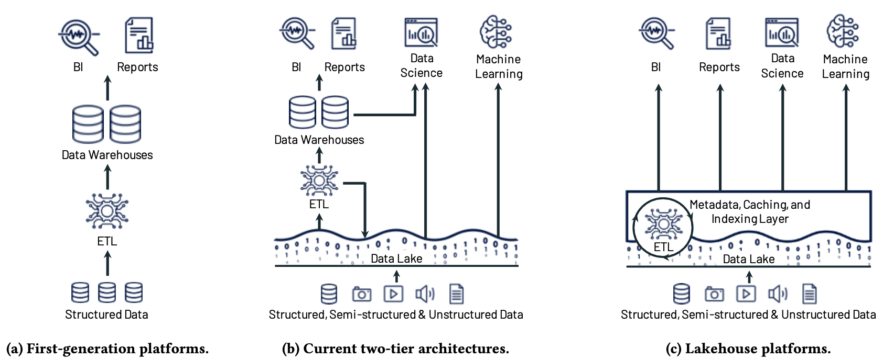
Evolution of data platform architectures
Evolution of data platform architectures to today’s two-tier model (a-b) and the new Lakehouse model (c)

Slide 11
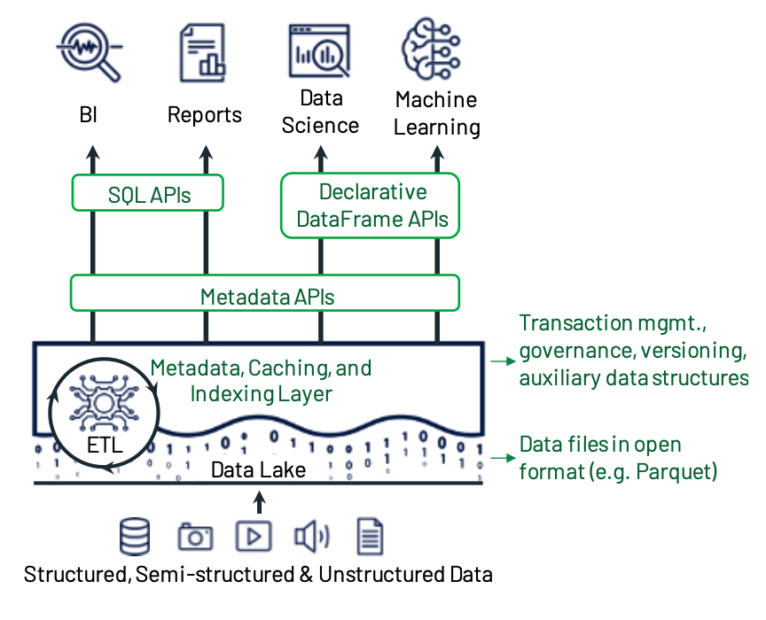
Example Lakehouse system design
The system centers around a meta- data layer such as Delta Lake that adds transactions, versioning, and auxiliary data structures over files in an open for- mat, and can be queried with diverse APIs and engines.

Slide 12
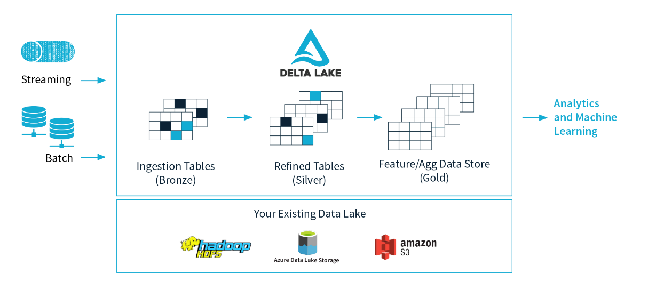
Lakehouse
Delta Lake

Slide 13
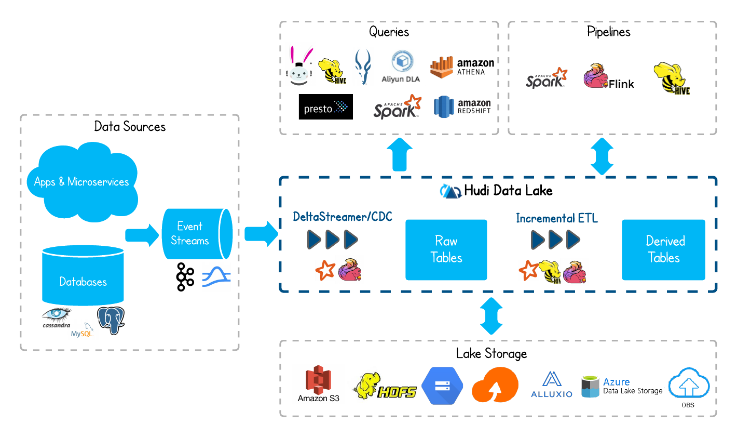
Lakehouse
Apache Hudi

Slide 14

Lakehouse
Apache Iceberg
Apache Iceberg is an open table format for huge analytic datasets.
Iceberg adds tables to compute engines including Spark, Trino, PrestoDB, Flink and Hive using a high-performance table format that works just like a SQL table.

Slide 15
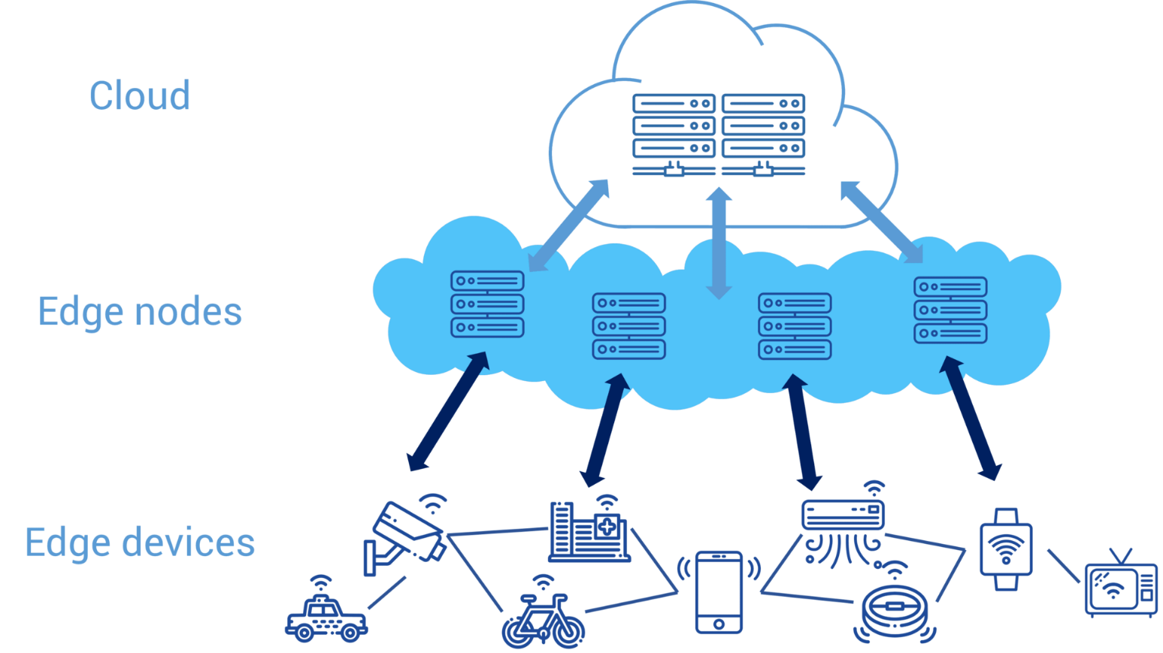
云边融合数据存储服务
过去
物联网设备 → 云数据中心
网络传输成为瓶颈
边缘计算服务
物联网设备 → 边缘计算节点
边缘计算节点 → 云数据中心
没有持久化服务带来的问题
设备移动性
数据丢失

Slide 16
云边融合数据存储服务
通用计算能力
→边缘计算
数据存储能力
→边缘存储
功能：
数据存储
数据分析

Slide 17
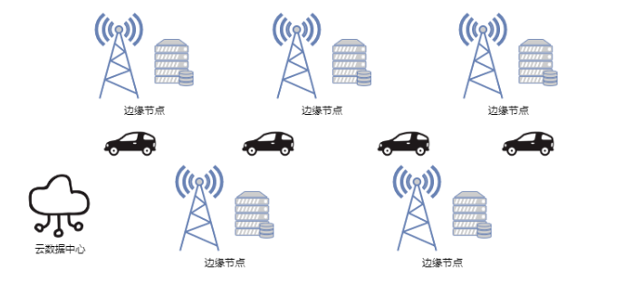
云边融合数据存储服务
数据特征
流式数据
数据量大
范围查询
现有边缘存储架构
文件为单位
文件tag或者KV搜索方式
数据要传回中心才能处理计算

Slide 18
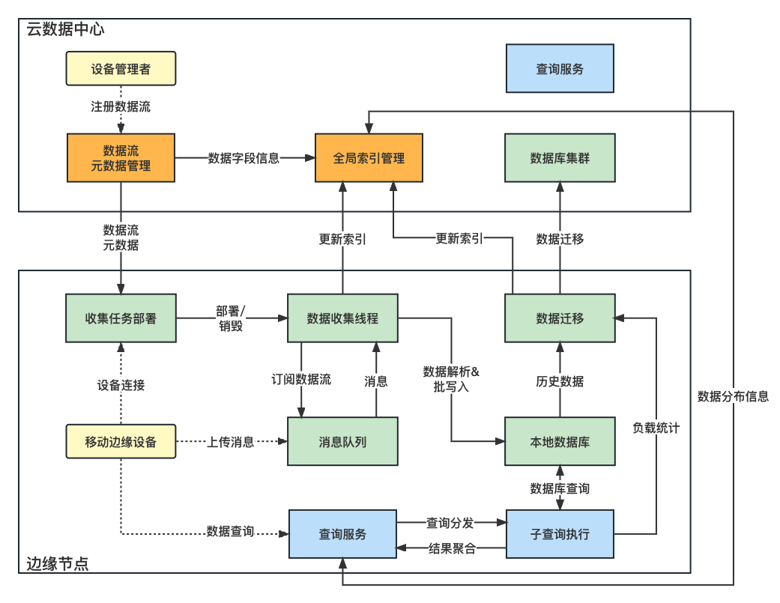
云边融合数据存储服务
边缘节点
数据收集
查询处理本地数据
云数据中心
元数据管理
数据索引来协作查询
数据备份

Slide 19
云边融合数据存储服务
数据收集流程
设备连接
元数据查询
创建数据收集线程
数据解析存储
收集任务部署模块
避免重复创建线程
数据流都离开后销毁线程
就近存储
网络开销小
地理空间维度聚集
空闲时迁移

Slide 20
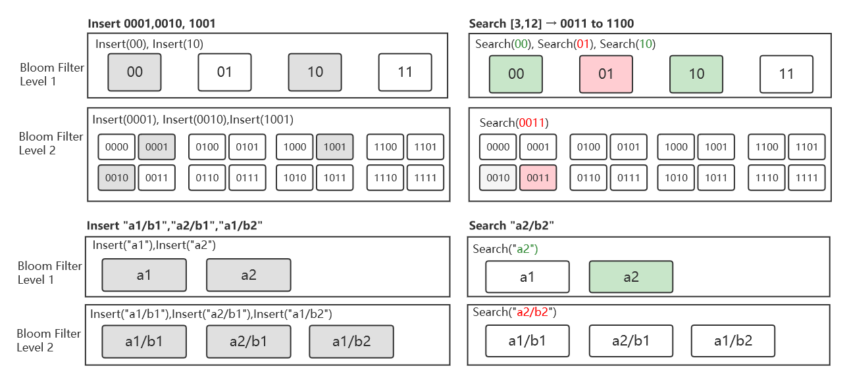
云边融合数据存储服务
分布式数据存储
全局数据索引
B+树
布隆过滤器
Rosetta过滤器
Mini- Rosetta过滤器

Slide 21
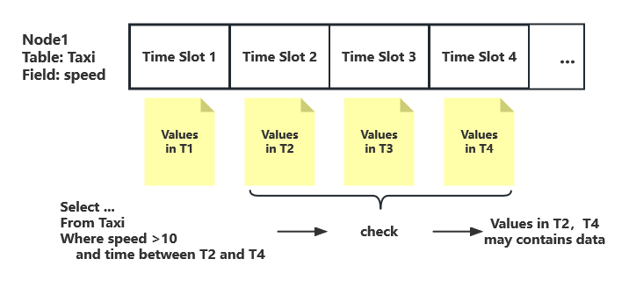
云边融合数据存储服务
索引流程
过滤器上传
存储到数据库
取出判断
问题
数据库查找性能问题
过滤器数量过多问题
复合查询问题
解决方案
内存中维护索引缓存
预聚合过滤器
时间分片

Slide 22
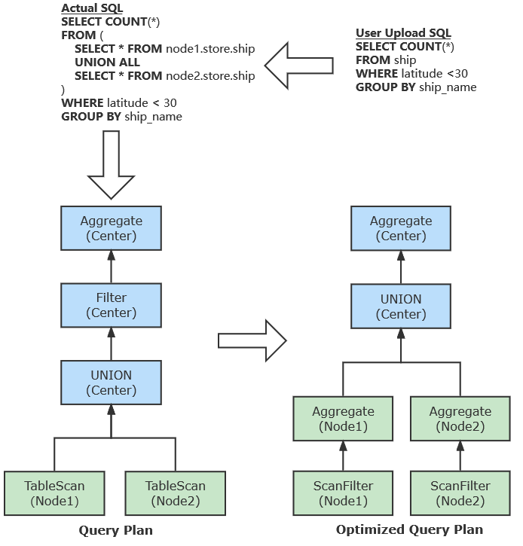
云边融合数据存储服务
数据分布存储
查询改写
分布式查询执行
分布式数据分析引擎Presto
解析生成Query Plan
查询优化
数据库SQL执行

Slide 23
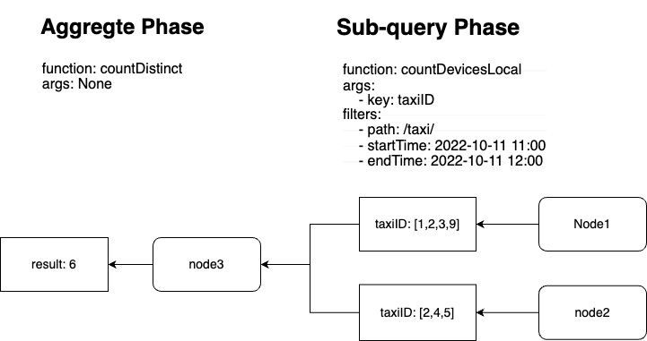
云边融合数据存储服务
两阶段查询
子查询阶段
聚合阶段
用户指定执行的任务和参数
查询服务根据过滤条件下发子查询

Slide 24
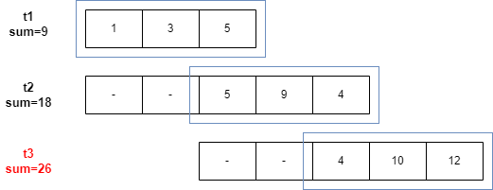
云边融合数据存储服务
边缘节点资源受限
访问其他节点服务
子查询阶段无法直接迁移
解决方案
记录访问开销
识别热点数据
迁移数据到数据中心

Slide 25
References
一文读懂Data Lake
https://blog.csdn.net/u011598442/article/details/106610486/
维基百科-data lake
https://en.wikipedia.org/wiki/Data_lake
Delta lake
https://delta.io/
Apache hudi
https://hudi.apache.org/
Apache Iceberg
https://iceberg.apache.org/
What is Data Lake
https://cloud.google.com/learn/what-is-a-data-lake
https://www.databricks.com/product/delta-lake-on-databricks
https://aws.amazon.com/what-is/data-lake/?nc1=h_ls
Lakehouse: A New Generation of Open Platforms that Unify Data Warehousing and Advanced Analytics
http://cidrdb.org/cidr2021/papers/cidr2021_paper17.pdf
Data lake vs data warehouse
https://www.talend.com/resources/data-lake-vs-data-warehouse/
Huang Z, Chen H, Gui L, et al. CEDS: Center-Edge Collaborative Data Service for Mobile IoT Data Management[C]//2022 IEEE International Conference on Web Services (ICWS). IEEE, 2022: 188-197

Slide 26

Thank You!

